Slide 1
Colloquium Realization of a SensorShoe
Date:16/09/2019
Student: Truong Thanh Toan
Instructor 1: Prof. Dr. Kuhn
Instructor 2: Prof. Dr. Hinkelmann

Slide 2
Contents:
Introduction
Approach
Hardware
Software
Conclusion
Demo
Reference
Notes:
sdcfvgbnjmk

Slide 3
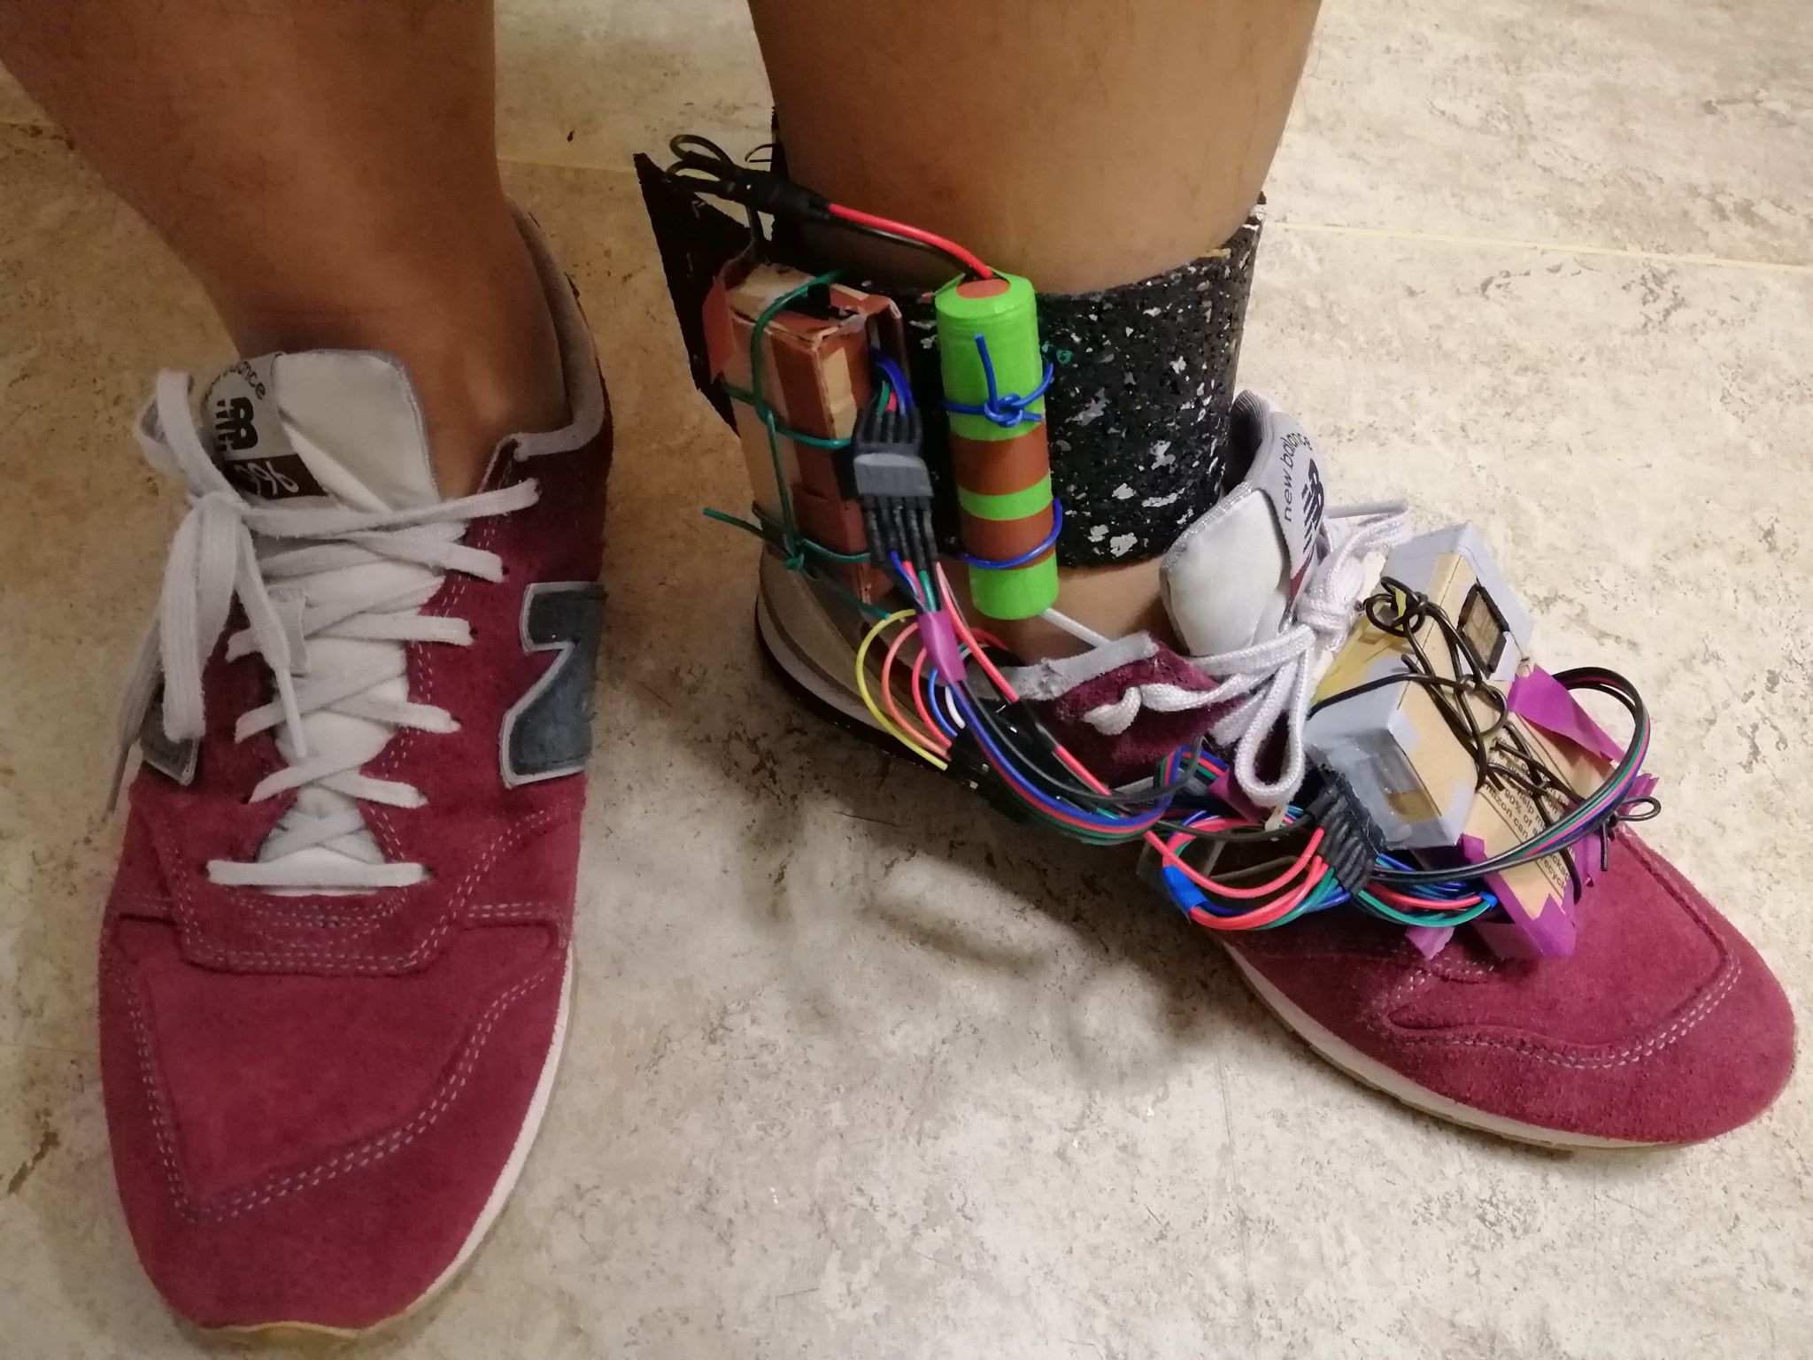
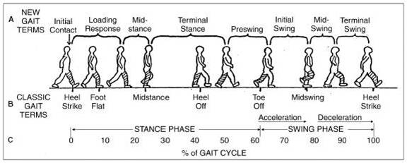
Introduction:
Gait Analysis.
The foot area
Realization of a SensorShoe

Slide 4
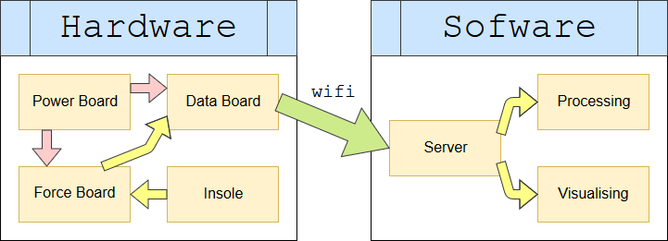
Approach:
A sensor-aided shoe which collects data and send them through wifi to a computer

Slide 5
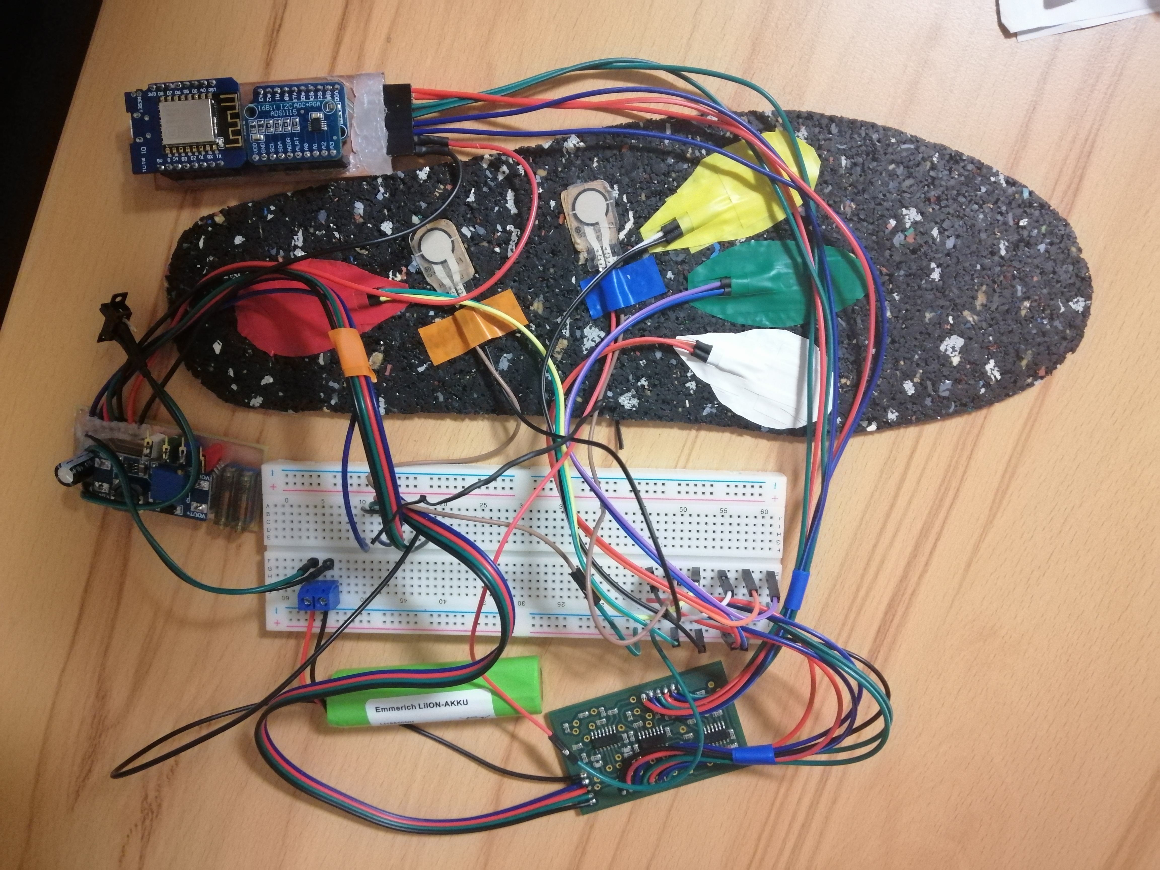
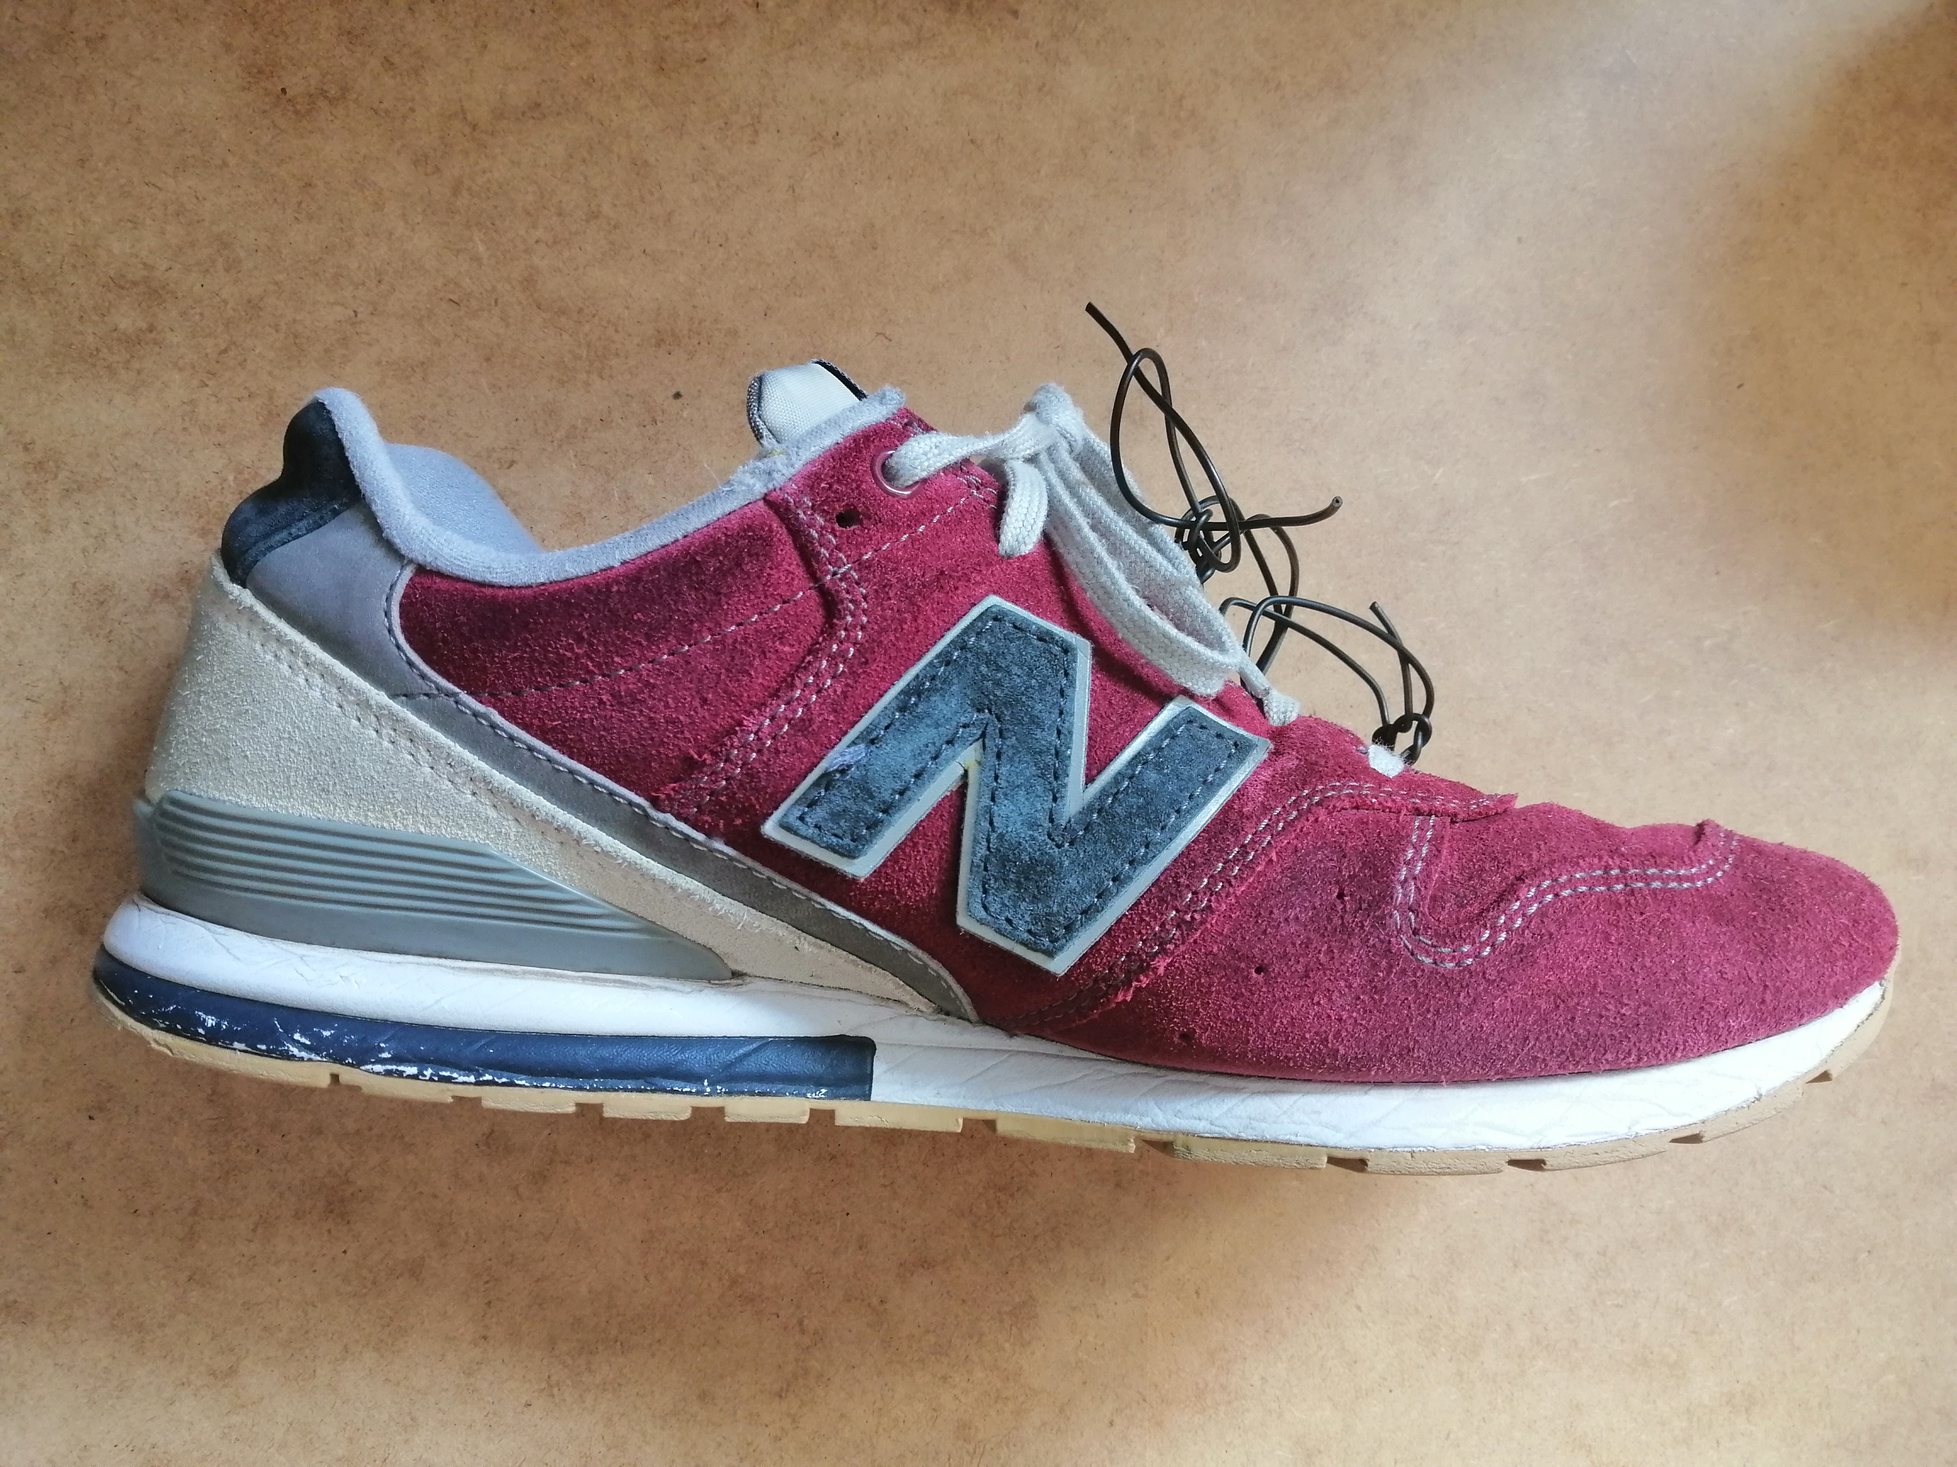
Hardware:
Power Board
Force Board
Data Board
Computer
Insole

Slide 6
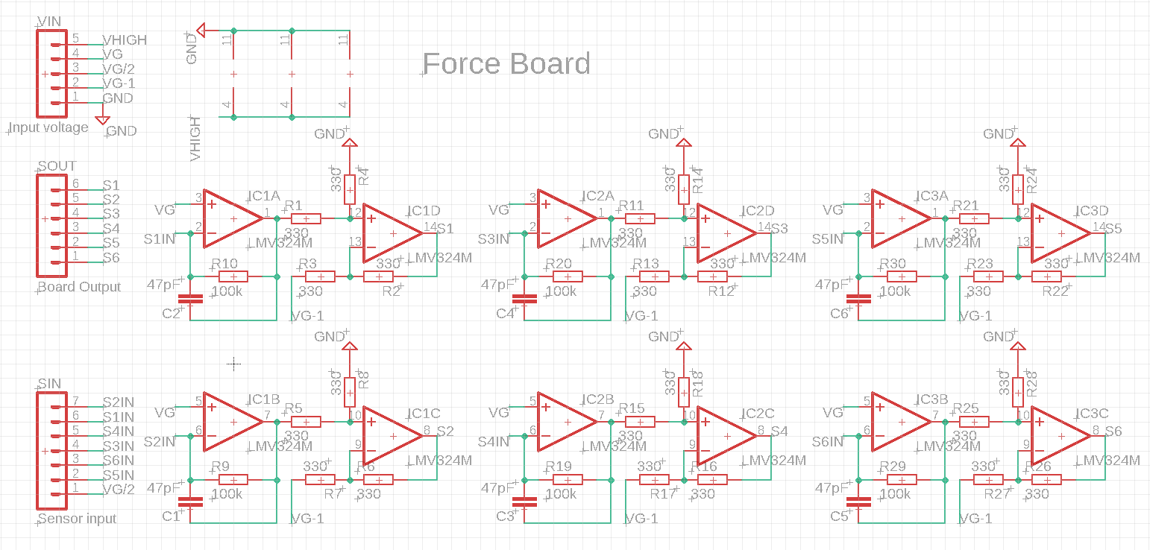
Force Board

Slide 7
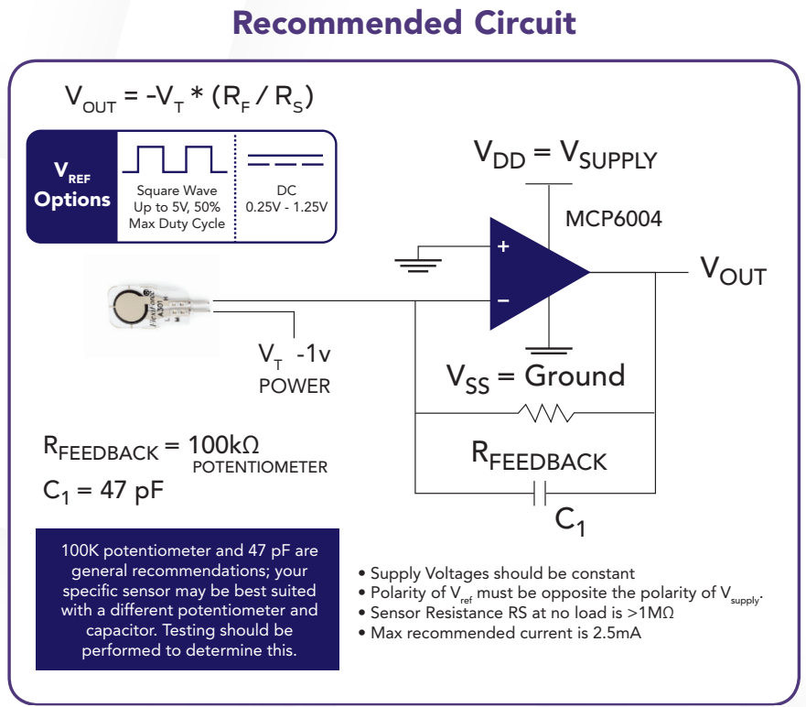
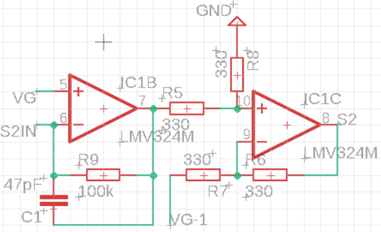
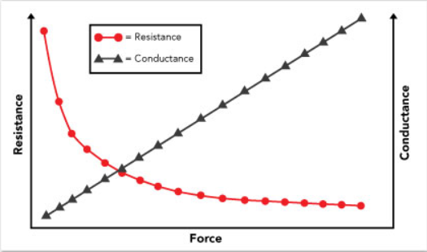
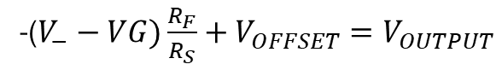
Force Board calculation
VHIGH
Vt
VG
V_
VG/2
VG-1
-($V_{−}−VG)\frac{R_{F}}{R_{S}}+V_{OFFSET}=V_{OUTPUT}$

Slide 8
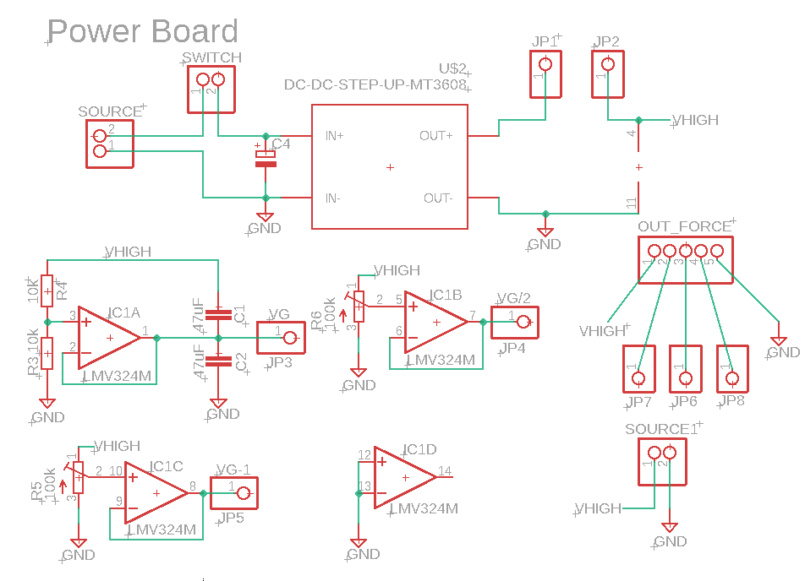
Power Board:
MT3608 DC-DC step-up converter
LMV324 OpAmps
Required Voltages

Slide 9
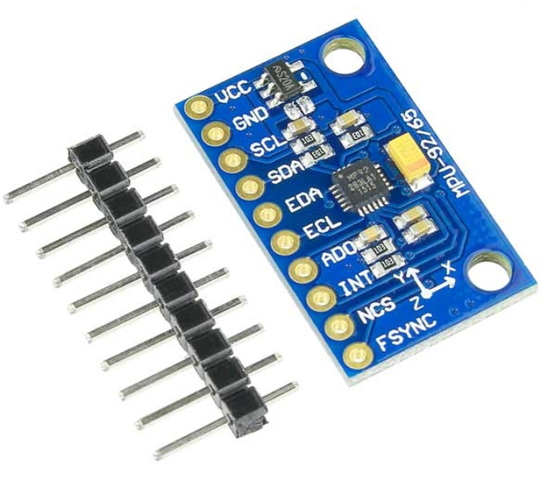
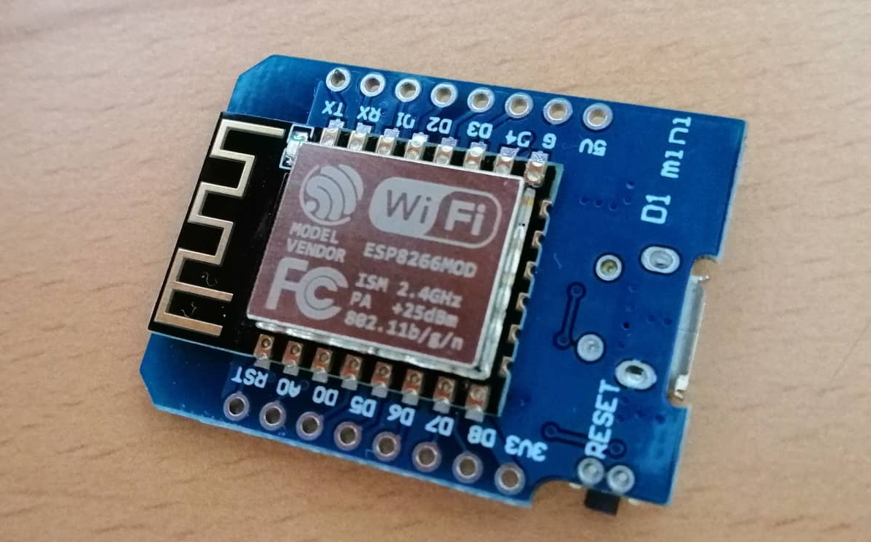
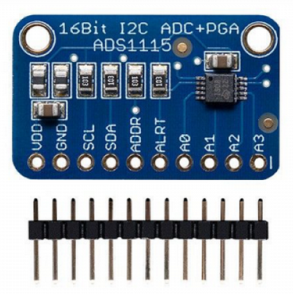
Data Board
ADS1115 ADC
MPU9250 IMU
Wemos D1-R1

Slide 10
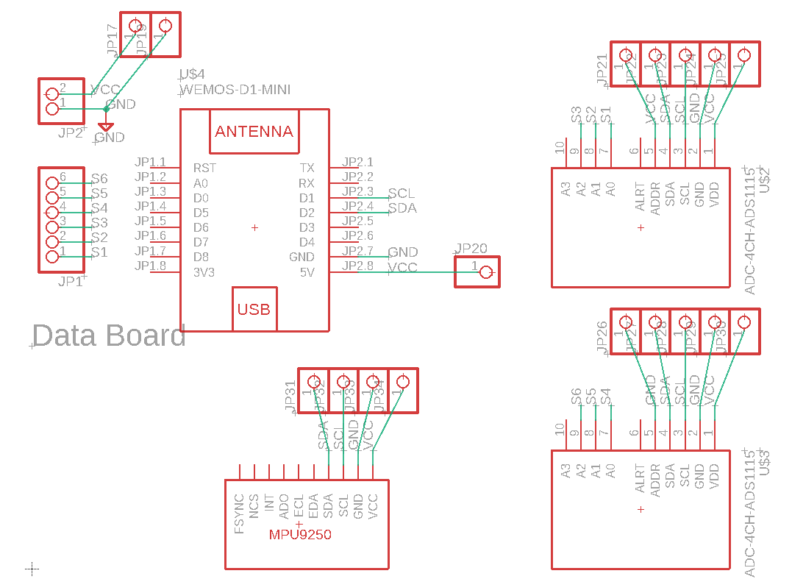
Data Board
Wifi
I2C

Slide 11
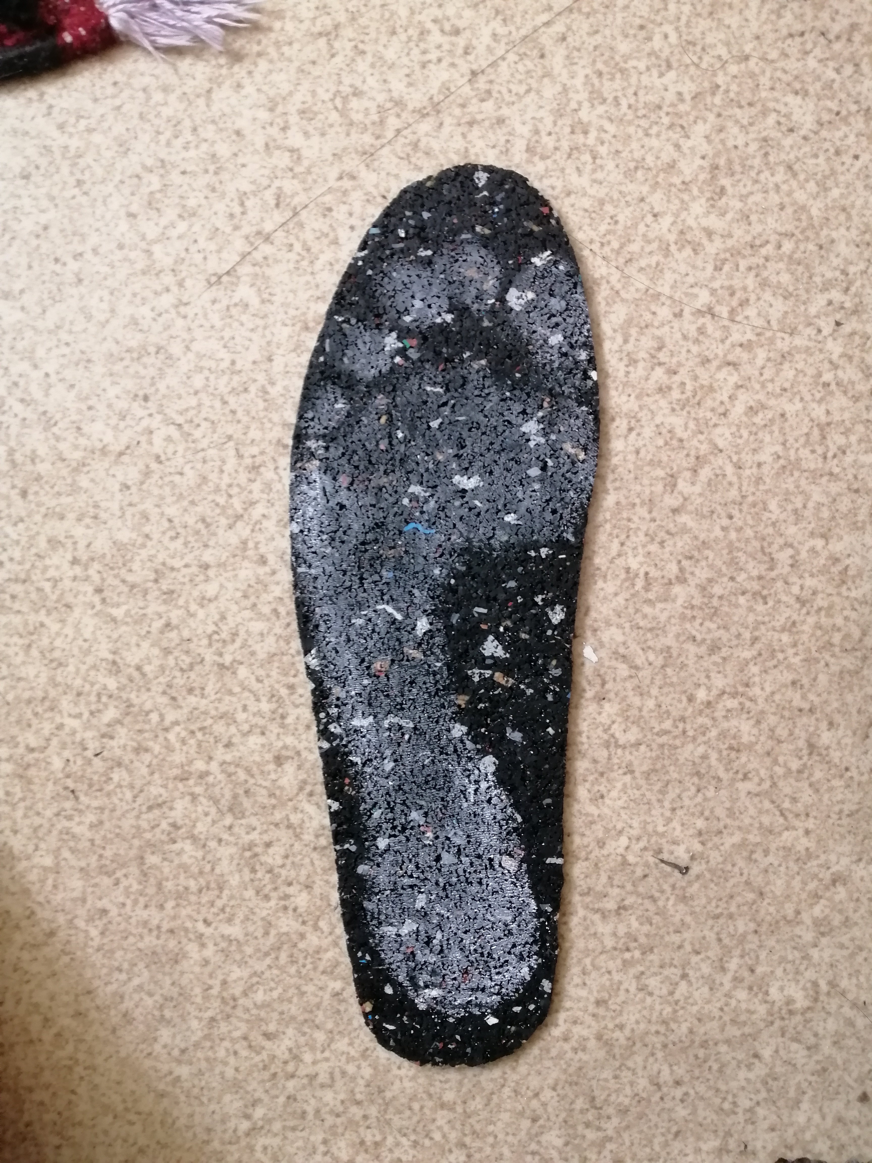
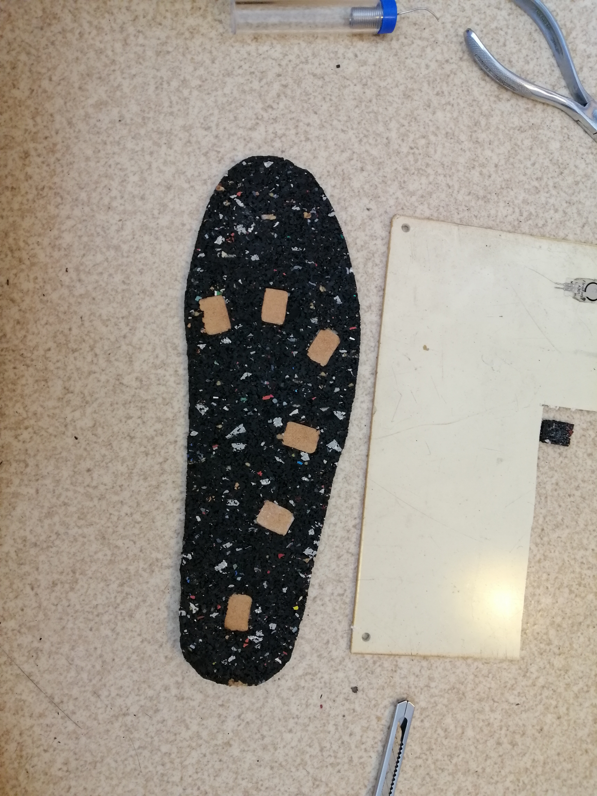
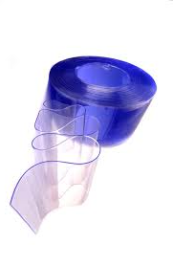
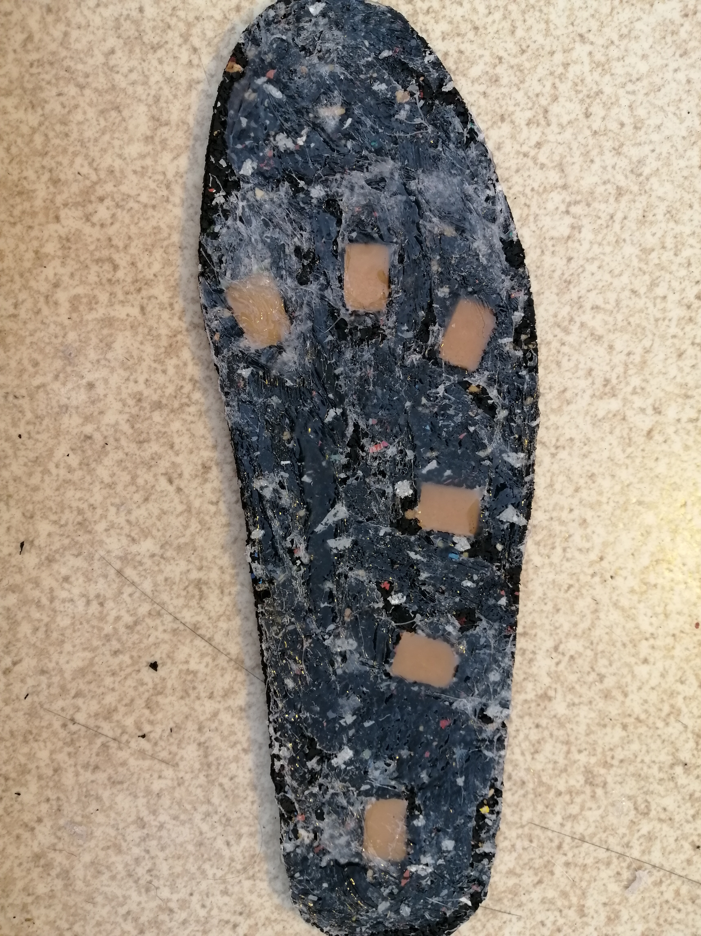
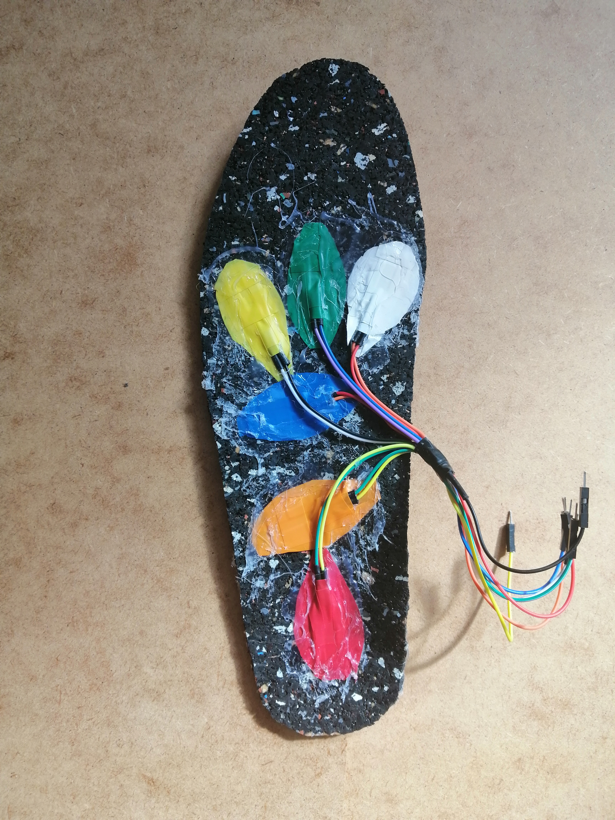
Insole

Slide 12

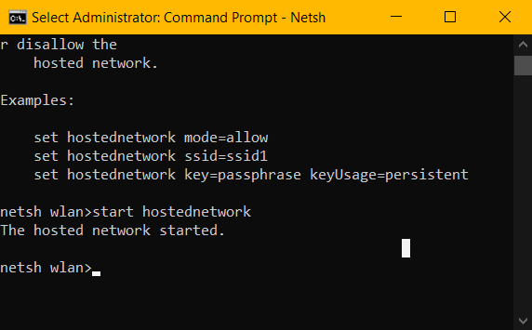
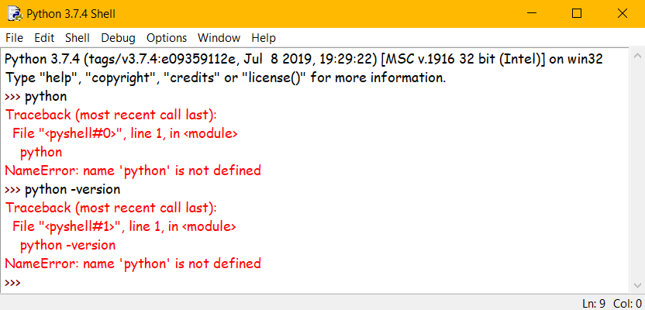
Software:
Arduino
Python
Windows 10

Slide 13
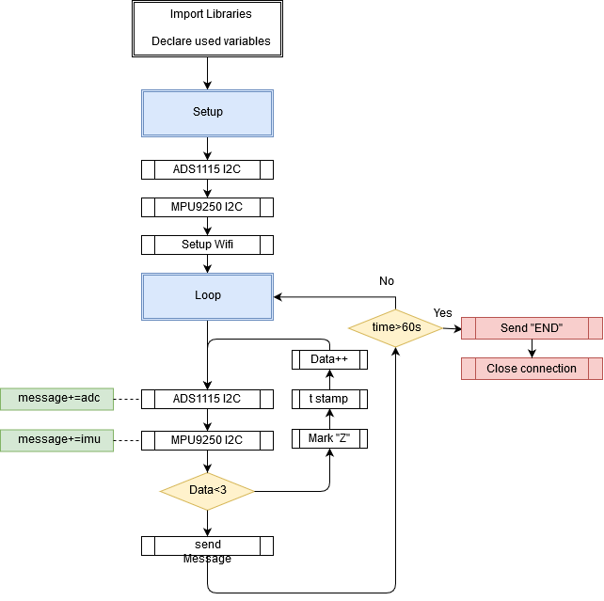
Arduino
Client
Wifi
I2C

Slide 14
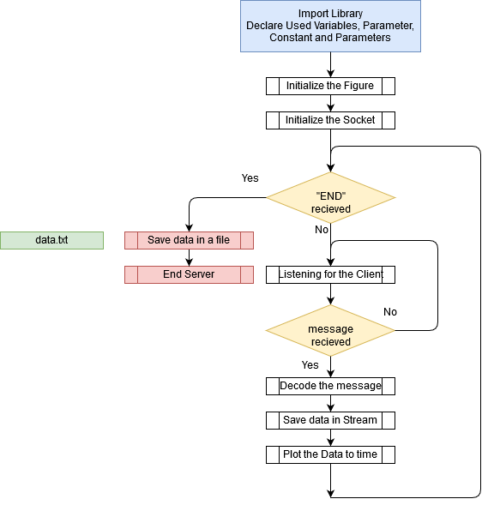
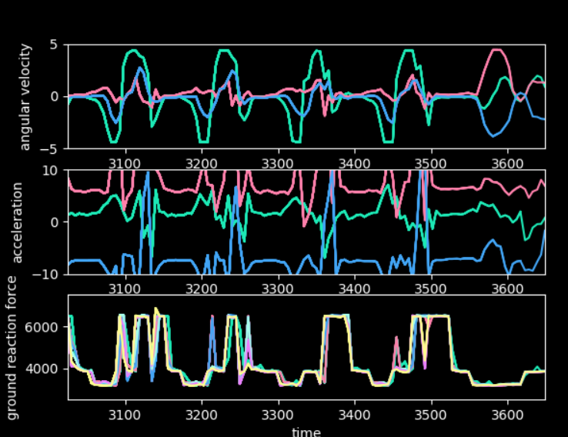
Python
Server
Matplotlib
Tcp/Ip Socket
Data Decoding

Slide 15
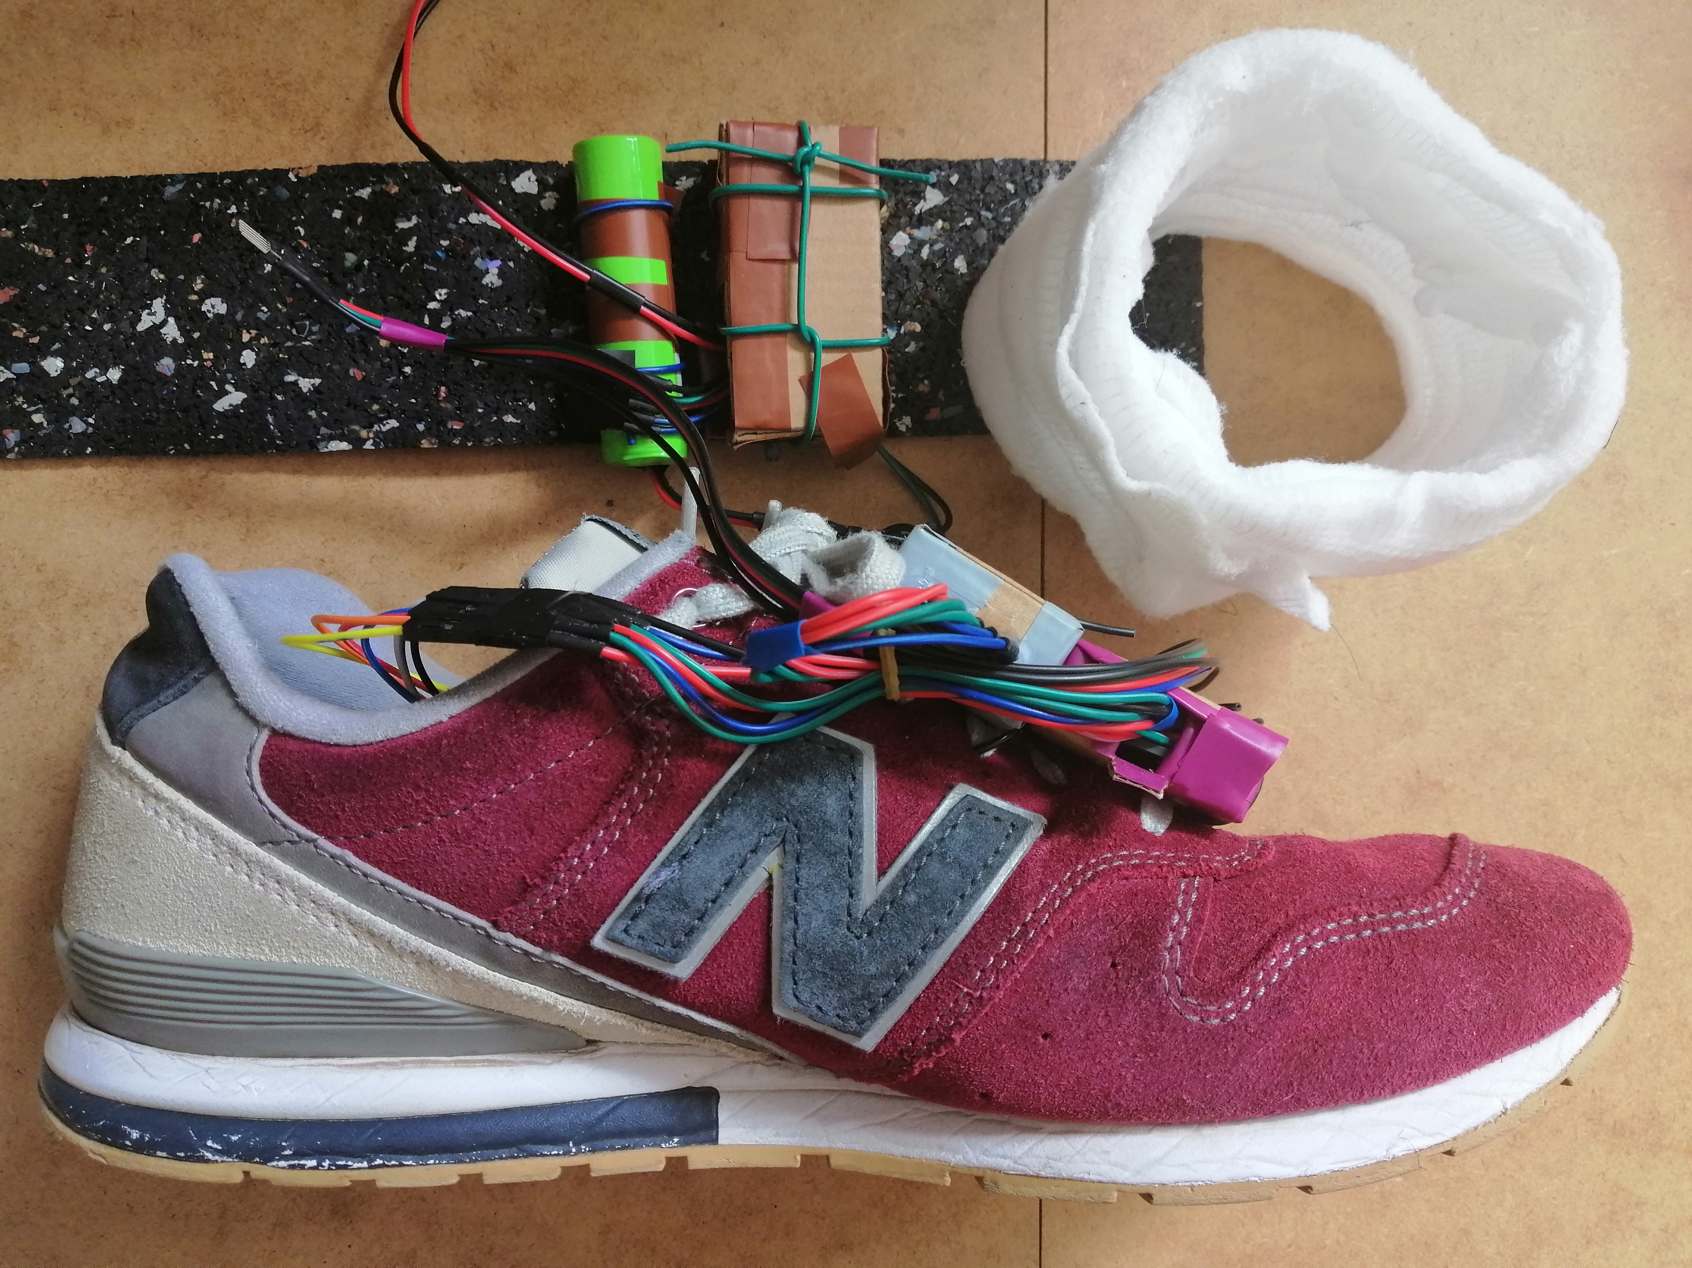
Conclusion:
Wearables
Prototype
Periodic Data
Improvement

Slide 16
Reference:
Refer to the references in the text

Slide 17
Thank you for your attention

Slide 18
Demo:
Faults
Improvements
Experiments

